Slide 1
Selection
Data Structures and Algorithms
Nanjing University, Fall 2024
郑朝栋

Slide 2
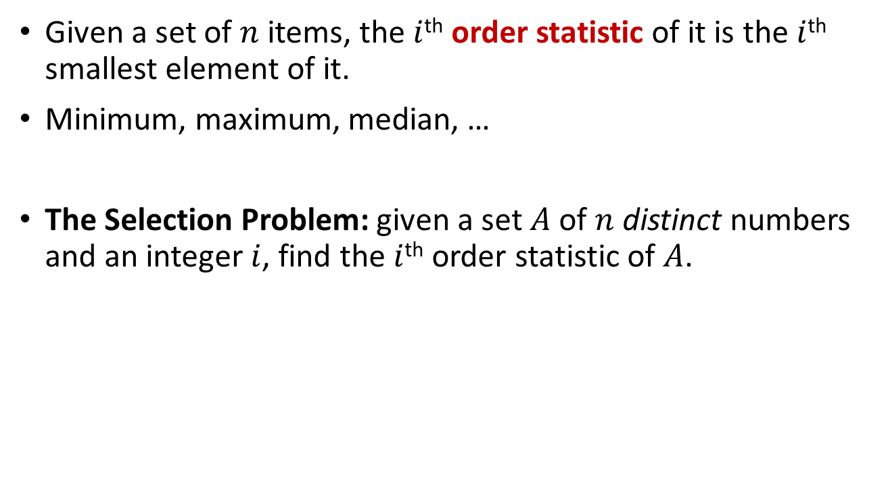
Order Statistics and Selection
Given a set of $n$ items, the $i$^{th} order statistic of it is the $i$^{th} smallest element of it.
Minimum, maximum, median, …
The Selection Problem: given a set $A$ of $n$ distinct numbers and an integer $i$, find the $i$^{th} order statistic of $A$.

Slide 3
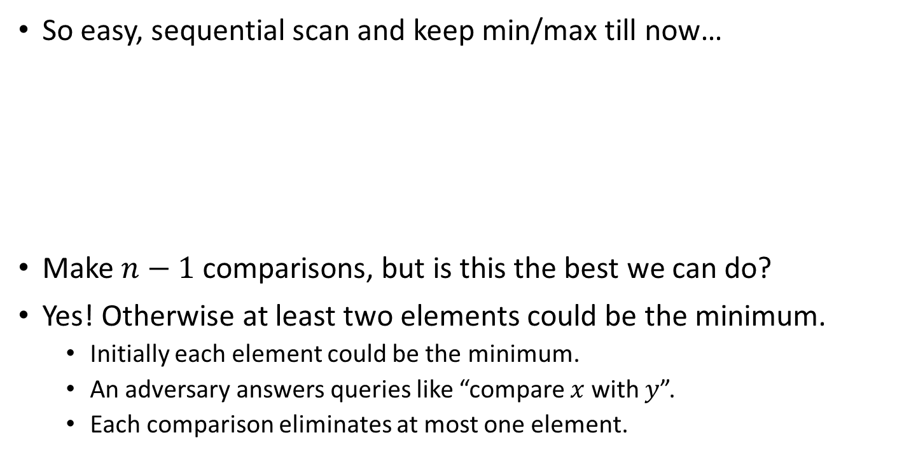
Find Min/Max
So easy, sequential scan and keep min/max till now…
Make $n−1$ comparisons, but is this the best we can do?
Yes! Otherwise at least two elements could be the minimum.
Initially each element could be the minimum.
An adversary answers queries like “compare $x$ with $y$”.
Each comparison eliminates at most one element.
FindMin(A):
min = A[1]
for (i=2 to A.length)
if (A[i]<min)
min = A[i]
return min

Slide 4

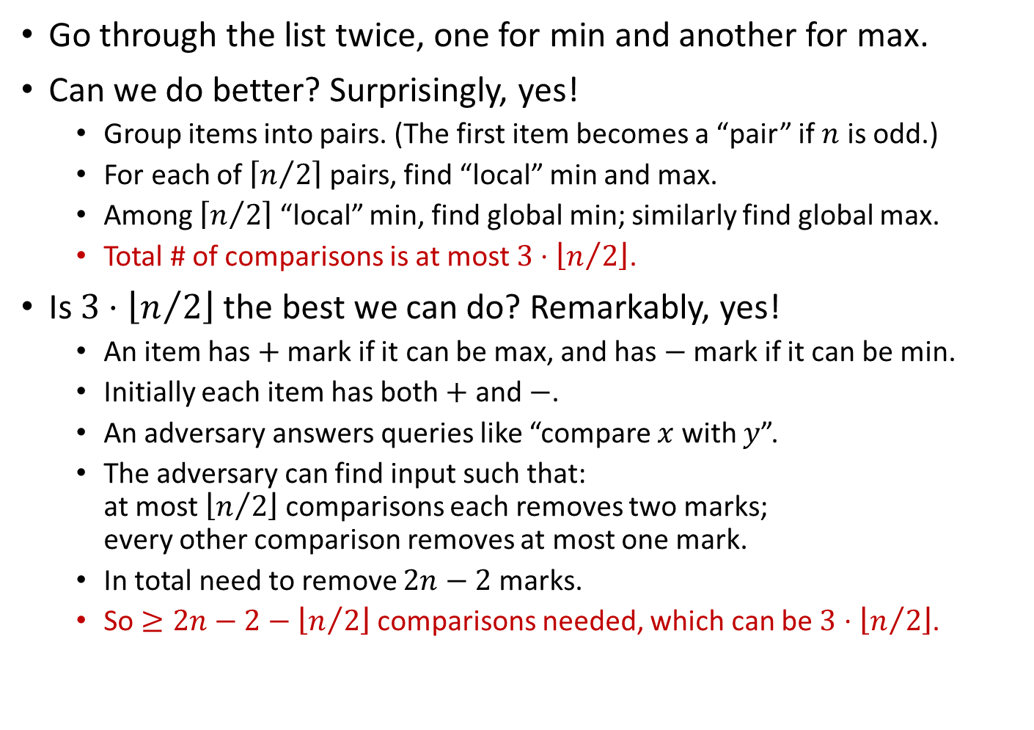
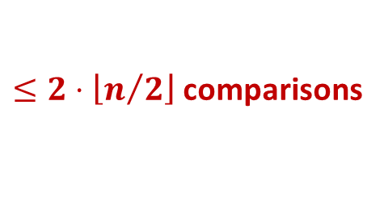
What if we want min and max?
Go through the list twice, one for min and another for max.
Can we do better? Surprisingly, yes!
Group items into pairs. (The first item becomes a “pair” if $n$ is odd.)
For each of $\left\lceil n/2\right\rceil$ pairs, find “local” min and max.
Among $\left\lceil n/2\right\rceil$ “local” min, find global min; similarly find global max.
Total # of comparisons is at most $3⋅\left\lfloor n/2\right\rfloor$.
Is $3⋅\left\lfloor n/2\right\rfloor$ the best we can do? Remarkably, yes!
An item has $+$ mark if it can be max, and has $−$ mark if it can be min.
Initially each item has both $+$ and $−$.
An adversary answers queries like “compare $x$ with $y$”.
The adversary can find input such that: at most $\left\lfloor n/2\right\rfloor$ comparisons each removes two marks; every other comparison removes at most one mark.
In total need to remove $2n−2$ marks.
So $≥2n−2−\left\lfloor n/2\right\rfloor$ comparisons needed, which can be $3⋅\left\lfloor n/2\right\rfloor$.
$\left\lfloor n/2\right\rfloor$ comparisons
$≤2⋅\left\lfloor n/2\right\rfloor$ comparisons

Slide 5

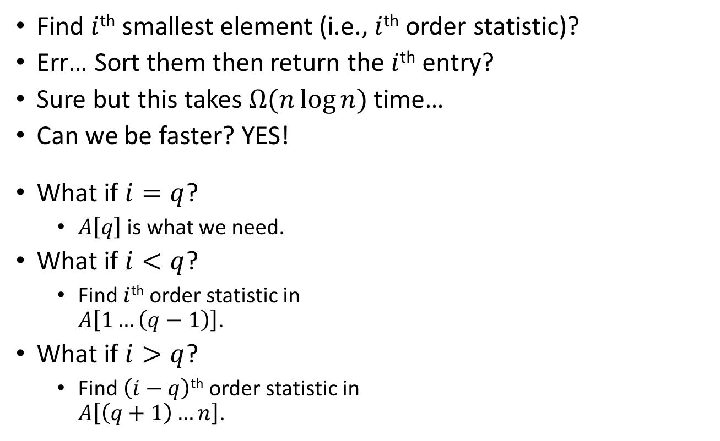
General Selection Problem
Find $i$^{th} smallest element (i.e., $i$^{th} order statistic)?
Err… Sort them then return the $i$^{th} entry?
Sure but this takes $Ω(n\log{n})$ time…
Can we be faster? YES!
What if $i=q$?
$A\left[q\right]$ is what we need.
What if $i<q$?
Find $i$^{th} order statistic in $A\left[1…\left(q−1\right)\right]$.
What if $i>q$?
Find $\left(i−q\right)$^{th} order statistic in $A\left[\left(q+1\right)…n\right]$.
RndQuickSort(A):
if (A.size>1)
q = RandomPartition(A)
RndQuickSort(A[1…(q-1)])
RndQuickSort(A[(q+1)…n])
Notice $A\left[1…(q−1)\right]$ contains the smallest $q−1$ elements in $A$.
This is Divide-and-Conquer!

Slide 6

Randomized Selection
RndSelect(A, i):
if (A.size=1)
return A[1]
else
q = RandomPartition(A)
if (i==q)
return A[q]
elseif (i<q)
return RndSelect(A[1…(q-1)],i)
else
return RndSelect(A[(q+1)…A.size],i-q)
A Divide-and-Conquer Alg.
Average Runtime?
$$Θ(n)$$
Best-case runtime?
Choose the answer as the pivot in the first call (unlikely to happen).
$$≥cn+c\left(n−1\right)+⋯+c\left(2\right)=Θ\left(n^{2}\right)$$
Worst-case runtime?
Partition reduces array size by one each time (unlikely to happen).

Slide 7

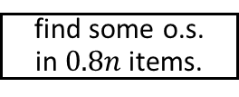

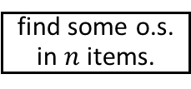
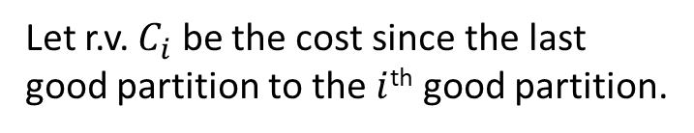
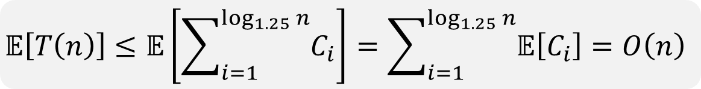
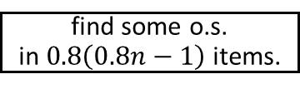

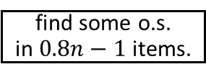

Best-case: chooses the answer as the pivot right away.
RndSelect(A, i):
if (A.size=1)
return A[1]
else
q = RandomPartition(A)
if (i==q)
return A[q]
elseif (i<q)
return RndSelect(A[1…(q-1)],i)
else
return RndSelect(A[(q+1)…A.size],i-q)
A Divide-and-Conquer Alg.
Worst-case: partition process only reduces problem size by one.
What’s likely to happen: partition process reduces problem size by a constant factor.
Call a partition good if it reduces problem size to at most 0.8*input_size.
$$C_{1}$$
find some o.s. in $n$ items.
Let r.v. $C_{i}$ be the cost since the last good partition to the $i$^{th} good partition.
find some o.s. in $0.8n$ items.
$$C_{2}$$
At most $\log_{1.25}{n}$ good partitions can occur.
find some o.s. in $0.8n−1$ items.
$$𝔼\left[C_{i}\right]≤Θ\left(1\right)⋅{0.8}^{i−1}n$$
find some o.s. in $0.8\left(0.8n−1\right)$ items.
$$𝔼\left[T\left(n\right)\right]≤𝔼\left[\sum_{i=1}^{\log_{1.25}{n}}{C_{i}}\right]=\sum_{i=1}^{\log_{1.25}{n}}{𝔼\left[C_{i}\right]}=O\left(n\right)$$
…
we are done.

Slide 8
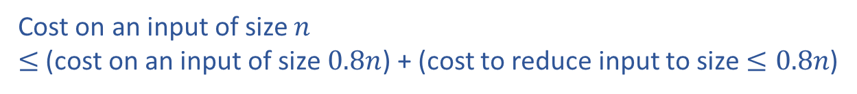


Best-case: chooses the answer as the pivot right away.
RndSelect(A, i):
if (A.size=1)
return A[1]
else
q = RandomPartition(A)
if (i==q)
return A[q]
elseif (i<q)
return RndSelect(A[1…(q-1)],i)
else
return RndSelect(A[(q+1)…A.size],i-q)
A Divide-and-Conquer Alg.
Worst-case: partition process only reduces problem size by one.
What’s likely to happen: partition process reduces problem size by a constant factor.
Cost on an input of size $n$ $≤$ (cost on an input of size $0.8n$) + (cost to reduce input to size $≤0.8n$)
$$𝔼\left[T\left(n\right)\right]≤𝔼\left[T\left(0.8n\right)\right]+𝔼\left[cost to reduce size n input to≤0.8n\right]$$
$$𝔼\left[T\left(n\right)\right]≤𝔼\left[T\left(0.8n\right)\right]+O(n)$$
$$𝔼\left[T\left(n\right)\right]=O\left(n\right)$$

Slide 9
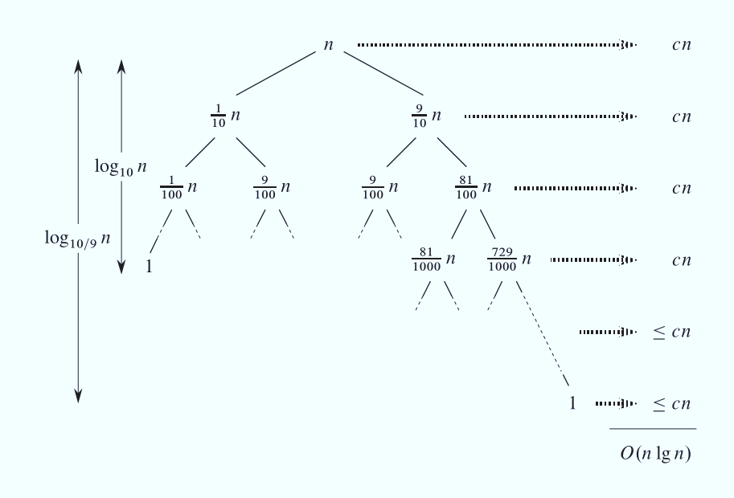


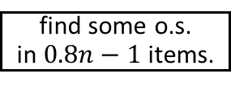
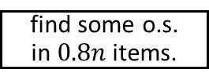
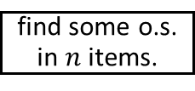
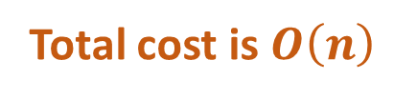
RndQuickSort vs RndSelect
RndSelect(A, i):
if (A.size=1)
return A[1]
else
q = RandomPartition(A)
if (i==q)
return A[q]
elseif (i<q)
return RndSelect(A[1…(q-1)],i)
else
return RndSelect(A[(q+1)…A.size],i-q)
RndQuickSort(A):
if (A.size>1)
q = RandomPartition(A)
RndQuickSort(A[1…(q-1)])
RndQuickSort(A[(q+1)…n])
find some o.s. in $n$ items.
$$C_{1}≤cn$$
find some o.s. in $0.8n$ items.
$$C_{2}≤c⋅0.8n$$
find some o.s. in $0.8n−1$ items.
…
Total cost is $O\left(n\right)$
we are done.

Slide 10

We are not done with selection…
Can we guarantee worst-case runtime of $O\left(n\right)$?
The reason that RndSelect could be slow is that RandomPartition might return an unbalanced partition.
Needs a partition procedure that guarantees to be balanced. (without using too much time; $O(n)$ time to be specific)
RndSelect(A, i):
if (A.size=1)
return A[1]
else
q = RandomPartition(A)
if (i==q)
return A[q]
elseif (i<q)
return RndSelect(A[1…(q-1)],i)
else
return RndSelect(A[(q+1)…A.size],i-q)

Slide 11





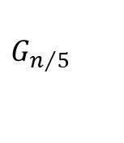


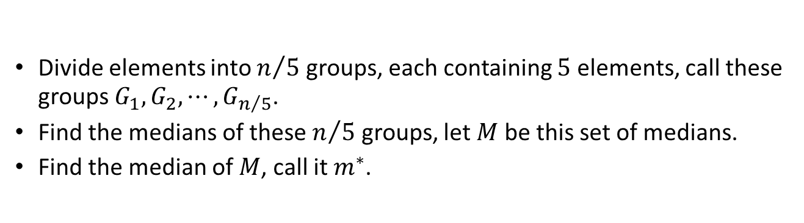








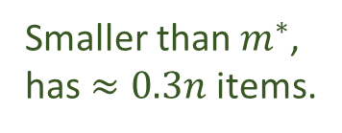



























Median of medians
Divide elements into $n/5$ groups, each containing $5$ elements, call these groups $G_{1},G_{2},⋯,G_{n/5}$.
Find the medians of these $n/5$ groups, let $M$ be this set of medians.
Find the median of $M$, call it $m^{∗}$.
Partition using $m^{∗}$ as pivot is good: the smaller split has $≥0.3n$ items.
Bigger than $m^{∗}$, has $≈0.3n$ items.
$$>$$
$$>$$
$$>$$
$$>$$
$$>$$
$$>$$
$$>$$
$$>$$
$$>$$
$$>$$
$$m^{∗}$$
$$>$$
$$>$$
$$>$$
$$>$$
$$<$$
$$<$$
$$<$$
$$<$$
$$<$$
$$<$$
$$M$$
$$>$$
$$>$$
$$>$$
$$>$$
$$>$$
$$>$$
$$>$$
Smaller than $m^{∗}$, has $≈0.3n$ items.
$$>$$
$$>$$
$$>$$
$$>$$
$$>$$
$$>$$
$$>$$
$$G_{1}$$
$$G_{2}$$
$$G_{3}$$
$$⋯⋯$$
$$G_{n/5}$$

Slide 12
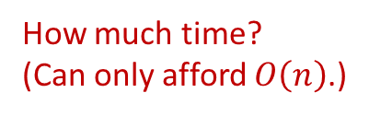
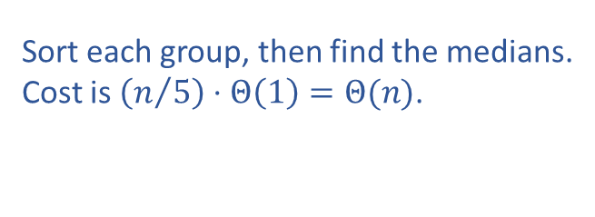

Finding median of medians
Divide elements into $n/5$ groups, each containing $5$ elements, call these groups $G_{1},G_{2},⋯,G_{n/5}$.
Find the medians of these $n/5$ groups, let $M$ be this set of medians.
Find the median of $M$, call it $m^{∗}$.
Trivial, $O(n)$ time.
Sort each group, then find the medians. Cost is $\left(n/5\right)⋅Θ\left(1\right)=Θ(n)$.
Use QuickSelect, recursively!
QuickSelect(A, i):
if (A.size=1)
return A[1]
else
m = MedianOfMedians(A)
q = PartitionWithPivot(A,m)
if (i==q)
return A[q]
elseif (i<q)
return QuickSelect(A[1…(q-1)],i)
else
return QuickSelect(A[(q+1)…A.size,i-q])
How much time?
(Can only afford $O\left(n\right)$.)
MedianOfMedians(A):
<G₁,G₂,…,G_{n/5}> = CreateGroups(A)
for (i=1 to n/5)
Sort(G_{i})
M = GetMediansFromSortedGroups(G₁,G₂,…,G_{n/5})
return QuickSelect(M,(n/5)/2)

Slide 13
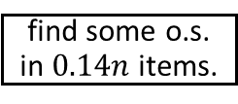
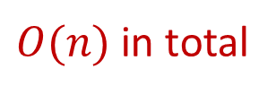
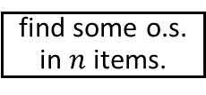
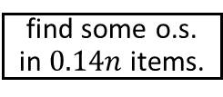

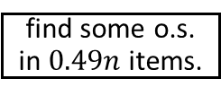

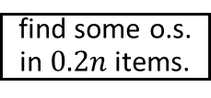

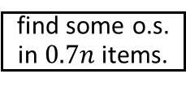
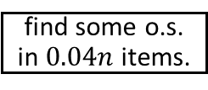
Time complexity?
MedianOfMedians(A):
<G₁,G₂,…,G_{n/5}> = CreateGroups(A)
for (i=1 to n/5)
Sort(G_{i})
M = GetMediansFromSortedGroups(G₁,G₂,…,G_{n/5})
return QuickSelect(M,(n/5)/2)
QuickSelect(A, i):
if (A.size=1)
return A[1]
else
m = MedianOfMedians(A)
q = PartitionWithPivot(A,m)
if (i==q)
return A[q]
elseif (i<q)
return QuickSelect(A[1…(q-1)],i)
else
return QuickSelect(A[(q+1)…A.size],i-q)
$$cn$$
find some o.s. in $n$ items.
$$T\left(n\right)≤T\left(0.7n\right)+T\left(0.2n\right)+O(n)$$
$$c\left(0.7n+0.2n\right)=0.9cn$$
find some o.s. in $0.7n$ items.
find some o.s. in $0.2n$ items.
$$0.81cn$$
find some o.s. in $0.49n$ items.
find some o.s. in $0.14n$ items.
find some o.s. in $0.14n$ items.
find some o.s. in $0.04n$ items.
$O(n)$ in total

Slide 14

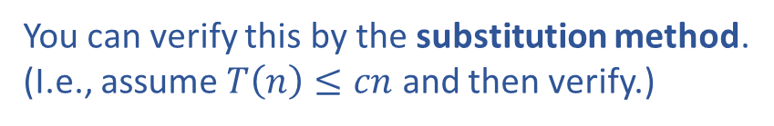
Time complexity?
MedianOfMedians(A):
<G₁,G₂,…,G_{n/5}> = CreateGroups(A)
for (i=1 to n/5)
Sort(G_{i})
M = GetMediansFromSortedGroups(G₁,G₂,…,G_{n/5})
return QuickSelect(M,(n/5)/2)
QuickSelect(A, i):
if (A.size=1)
return A[1]
else
m = MedianOfMedians(A)
q = PartitionWithPivot(A,m)
if (i==q)
return A[q]
elseif (i<q)
return QuickSelect(A[1…(q-1)],i)
else
return QuickSelect(A[(q+1)…A.size],i-q)
$$T\left(n\right)≤T\left(0.7n\right)+T\left(0.2n\right)+O(n)$$
$$T\left(n\right)=O\left(n\right)$$
You can verify this by the substitution method.
(I.e., assume $T\left(n\right)≤cn$ and then verify.)

Slide 15
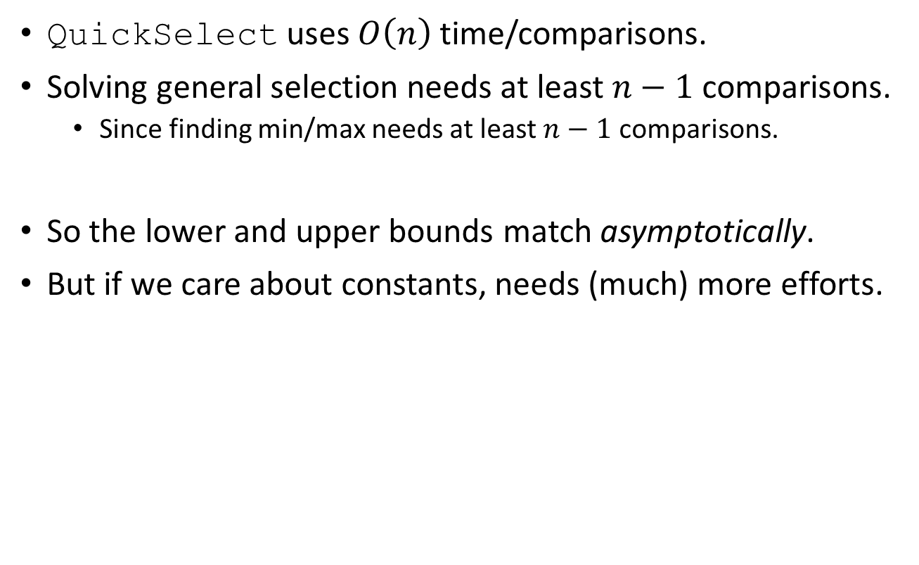
Complexity of general selection
QuickSelect uses $O\left(n\right)$ time/comparisons.
Solving general selection needs at least $n−1$ comparisons.
Since finding min/max needs at least $n−1$ comparisons.
So the lower and upper bounds match asymptotically.
But if we care about constants, needs (much) more efforts.

Slide 16
Reading
[CLRS] Ch.9

